Slide 1
APP DEVELOPMENT (OBJECT DETECTION)
FACE MASK DETECTION
Notes:
Cyber Team:
Team Lead: V.Tanush Kumar
Team Members:
P.Rohit Sai Kishor
M.VenkateshB.Bhagavan
S.Raghavendra

Slide 2
CYBER TEAM
Team Lead:V.Tanush Kumar
Team Members:
M.Venkatesh
B.Bhagavan
P.Rohit Sai Kishor
S.Raghavendra

Slide 3
SCOPE
In this present project to create a app to detect the face mask of a person.
By using this app we can easily find the person who is wearing the mask and who is not.
And this app is using to detect the persons wearing mask in the entrance of hospitals,malls and etc....
In this present days face detection using every where due to covid19.

Slide 4
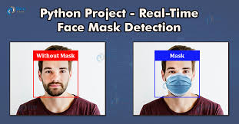
REAL TIME EXAMPLE

Slide 5
PROCESS
In this project first we are writing a program to detect a person face which was scaned by a camera or a picture which was given by us.
In second step we are giving instructions to find a mask.By giving the shape of a mask and where the mask is placing on the face or position of the mask on the face.

Slide 6
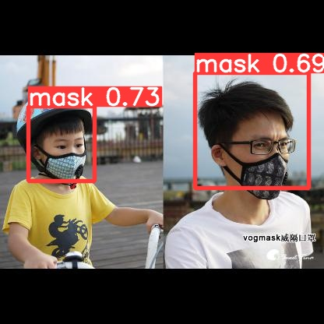


Slide 7
In third step we are giving instructions to detect a human face weather the person wearing mask or not.
In final the app will give the out put weather the person scaned by camera or a picture given by us wearing mask or not.It will give as weared mask or not weard

Slide 8

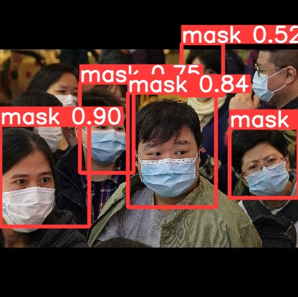
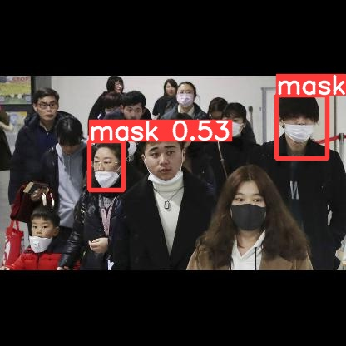

Slide 9
ADVANTAGES
Due to this covid situation the mask detection is using everywere to avoid spreading of COVID19.
For example the face mask detection is using in entrance of Colleges also.
And by using this face mask detection we can control the COVID19.

